Slide 1
Valley works Lithium valley Workforce and Economic Development Needs assessment Informational Proposers’ Webinar
January 8, 2024 – 10:00 a.m.PST – via zoom

Slide 2
About this session…
Present an overview of the RFP
Provide some insight
Support your planning about how to approach the project
Help you to formulate questions, which you’ll send to us. We’ll respond through published responses in the ICWDB website.

Slide 3
Project overview
Purpose: The RFP seeks expert services to conduct a Lithium Valley Workforce and Economic Development Needs Assessment
Background: The discovery of lithium, along with other rare minerals, at the Salton Sea Known Geothermal Resource Area (KGRA) is anticipated to result in local economic change and creation of new jobs in lithium extraction and, possibly, use of these materials in manufacturing of batteries and other consumer products. ICWDB received a Workforce Innovation and Opportunity Act (WIOA) grant from California EDD to commission the Needs Assessment. Following receipt of input from a wide range of stakeholders, the Valley Works Steering Committee was formed to guide the development of this RFP.

Slide 4
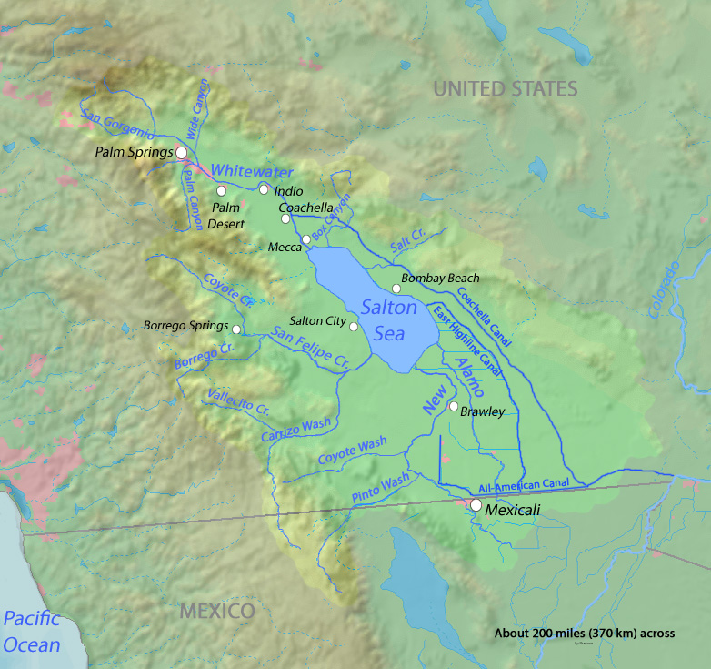
Objectives: - Analyze economic and workforce opportunities presented by the Lithium Valley Opportunity. - Assess current workforce capacity and assess economic opportunities for the expansion and development of a lithium extraction and processing industry cluster. - Identify barriers to economic and workforce expansion and improvement that exist in the county. - Establish goals and benchmarks for increases in workforce and economic development. - Develop recommendations and a plan of action for implementing workforce and economic development improvements.

Slide 5
Project Design and Deliverables
Services: Conduct a Lithium Valley Workforce and Economic Development Needs Assessment and develop a corresponding report, including recommendations, on the results of the assessment.
Outcomes:
Analysis of Current Economy and Workforce
Analysis of Potential Changes to the Economy and Workforce Resulting from the Lithium Valley Opportunity and Other Factors
Recommendations to Prepare for Economic and Workforce Changes

Slide 6
Deliverables:
A needs assessment completed in accordance with a plan developed by the proposer and agreed to by the ICWDB.
A report summarizing results of the assessment and outcomes stated in the RFP.
Recommendations for a “road map” and “plan of action” by the County, ICWDB, and stakeholders.
A presentation to the ICWDB and other local stakeholders.

Slide 7
Proposal Requirements and Required Proposal Content
Eligible Proposers: A private firm, non-profit entity, or public institution with substantial experience and expertise in conducting assessments and developing recommendations and reports of the type requested; or joint ventures of such entities. For joint ventures, a lead agency will serve as fiscal agent. A signed Partnership Agreement Letter must be included in the proposal.
Project Term: May 1, 2024 (approx.) and a firm end date of June 30, 2025
SAM Registration: Proposers must register with the federal System for Award Management (SAM).

Slide 8
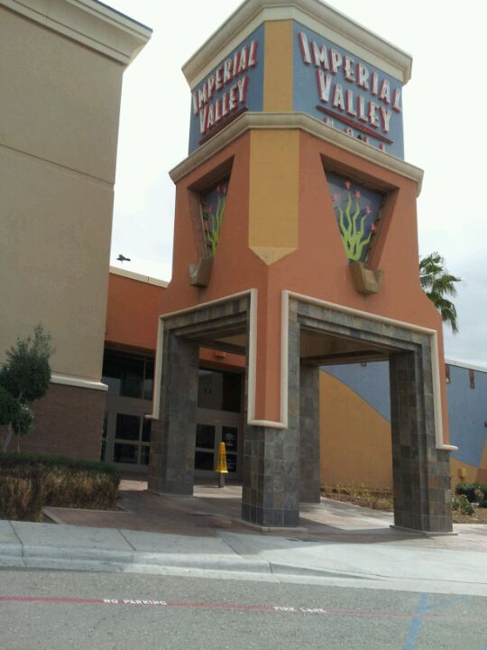
Required Contents of Proposals:
Proposal Cover/Signature Page (Form A).
Proposal Narrative (Form B)
Proposal Budget (Form C)
Proposal Budget Narrative (Form D)
Proposer’s Work Plan (Form E)
Proposer’s References (Form F)
Proposer’s Work Samples (Form G)
Resumes of Project Team Identified in the Budget (required)
Partnership Agreement Letter (applicable to joint venture proposals).(if applicable)
Formatting: Most documents are “fill in the blank.” The Proposal Narrative must be completed using Form B. The narrative must not exceed 20 pages, and proposers must use a 12-point font, single line spacing, and 1-inch margins.

Slide 9
Funding and Budget Requirements
Project Funding: A total of $650,000 in WIOA Title I Governor’s Discretionary Grants funding from California EDD is available through this RFP.
Allowable Use of Project Funds: Funds must be used to achieve the objectives of this RFP. Use of funds is governed by: 1) WIOA and its associated federal regulations; (2) state and federal directives and guidance publications; and (3) the Federal OMB Uniform Guidance for Grants and Agreements.
Administrative and Indirect Costs: Administrative charges may not exceed 10%. Proposers charging indirect costs must indicate how they are determined (Negotiated Indirect Cost Rate Agreement (NICRA), Cost Allocation Plan (CAP), or De Minimis.

Slide 10
Proposal Submission
Significant Dates:
Publication of RFP on ICWDB website - December 20, 2023
Informational Proposers’ Webinar (optional) - January 8, 2024
Notice of Intent to Apply Due (optional) - February 1, 2024
RFP Q&A process closes - February 19, 2024
Final Q&A response published - February 23, 2024
Proposals due via email by 5:00 p.m. PST - March 1, 2024
Announcement of proposal recommended for funding - March 18, 2024
Estimated project start date - May 1, 2024

Slide 11
Notice of Intent to Apply: Proposers are encouraged to notify the ICWDB of their intent to apply for this funding opportunity.
Submission Format: The Cover/Signature page must be submitted with a scanned original signature in PDF format. All other forms must be submitted in MS Word, with required hyperlinks, as appropriate. Partnership Agreement Letters and resumes should be submitted in PDF format.
Proposers’ Questions: ICWDB will respond to questions by publishing a “question and answer” summary on its website on the following dates: January 5, 2024, January 19, 2024, February 2, 2024, February 16, 2024, and February 23, 2024.
Ex Parte Communication: Ex parte communication regarding this RFP is prohibited. This include any communication with members of ICWDB, members of the Imperial County Board of Supervisors, employees of the County of Imperial, or members of the Valley Works Steering Committee.
Electronic Submission of the Proposal: Proposers must submit by email a complete proposal package (as a ZIP file) by 5:00 p.m. PST on March 1, 2024.

Slide 12
Contract Award
Rating: Staff will conduct an initial compliance review. An Evaluation Committee will review, rate, and rank proposals. Up to 100 points are available. The Committee retains the right to conduct applicant interviews
Appeals: After the rating process is completed, a notice of funding will be issued to all proposers. Proposers will have five working days after the notice date to file an appeal. Appeals will be addressed and decided on by the ICWDB.
Award Notification: ICWDB officials will notify the recommended proposer of the Imperial County’s intent to make an award to and enter into a contract with the proposer as a result of this RFP.

Slide 13
Administrative Requirements
Monitoring and Audits
Record Retention
Reporting
Project Closeout
Compliance
Intellectual Property Rights/Creative Common Attribution License
Public Communication-Certain Information Requirements

Slide 14
Technical Appendices Proposal Package Instructions: For each required form, project team resumes, and Partnership Agreement Letters, format guidelines are provided. Allowable Costs and Costs Matrix: WIOA and federal OMB rules are provided. Administrative Costs: WIOA definition of administrative costs are provided.

Slide 15
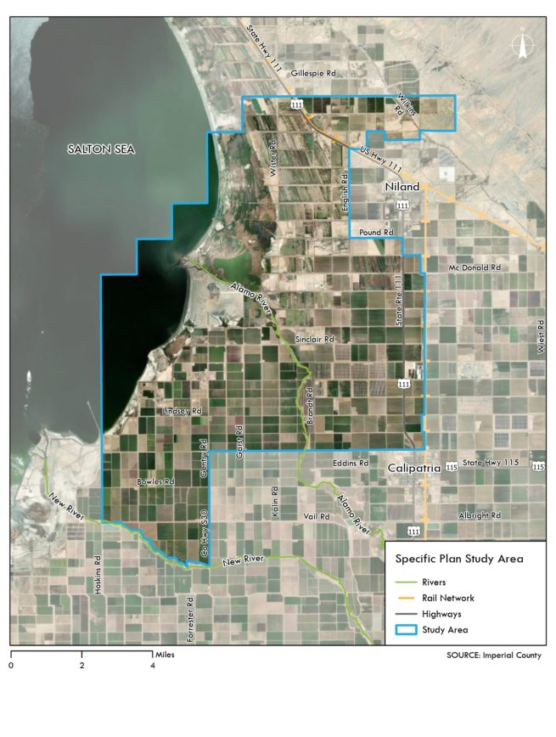
Informational Appendices
ICWDB is providing proposers with information that may support their development of thoughtful, well-informed plans and approaches to address the objectives of the project.
Imperial County Demographics: The county’s demographics are unique within the state and the nation. Imperial County’s proximity to the Mexican border has long influenced a diverse large multicultural community.
Economic Profile of Imperial County: The county economy is, principally, based on agriculture, but has diversified in recent decades. Still lacking are a strong manufacturing base, sizable transportation and logistics hubs, and other industries that characterize California’s overall economy.
Workforce Development System and Resources: The public workforce system drives coordination among workforce development stakeholders throughout the Imperial Valley.

Slide 16
Public Education Resources: Imperial County is home to a campus of San Diego State University, Imperial Valley College, Imperial Valley Regional Occupational Program, the Office of Education, and 16 school districts.
Imperial County Assets and Challenges: Imperial County considers it residents its chief asset. The county is among the most bilingual and bicultural in the nation. Other assets include land and housing affordability. An array of challenges may impede economic growth and development of the workforce.
Unique Geography and Location: Imperial County is uniquely situated at the Southernmost portion of California and is the state’s only rural county which borders two of California’s most populous, along with Arizona and Mexico.
Lithium Valley Opportunity: The discovery of lithium and other rare minerals with industrial applications at the Salton Sea is a potential economic game changer for Imperial County. The most important use of lithium is in rechargeable batteries for mobile phones, laptops, digital cameras, and electric vehicles.
Business and Industry Projections: Currently, there are three major businesses with high value investments in the KGRA: EnergySource Minerals, Controlled Thermal Resources, and Berkshire Hathaway Energy Renewables (BHE Renewables).
Lithium Valley Initiatives: Reports, studies, tax incentives, community outreach, business attraction, development of skills training, and much more have already resulted from the Lithium Valley opportunity. Private industry, government at all levels, economic development agencies, and community organizations are among those mobilizing efforts to benefit from this opportunity.
Community Input and Priorities: The Valley Works Steering Committee organized a series of community conversations in the Salton Sea area and throughout Imperial County to discuss priorities in terms of jobs and the local economy.

Slide 17
Proposal forms and Content
Proposal Cover/Signature Page (Form A).
Proposal Narrative (Form B)
Proposal Budget (Form C)
Proposal Budget Narrative (Form D)
Proposer’s Work Plan (Form E)
Proposer’s References (Form F)
Proposer’s Work Samples (Form G)
Content that is Not a Form
Resumes of Project Team Identified in the Budget (required)
Partnership Agreement Letters (if applicable)

Slide 18
Form A: Proposal Cover/Signature Page
The proposal cover/signature page serves as the introductory section for your proposal. The section includes details such as Project Title, Proposer Organization Name, Contact Information, and the Proposed Budget.
Form B: Proposal Narrative
The proposal narrative gives the proposer the opportunity to provide detailed descriptions of its capabilities and experience; approach to conducting the needs assessment; and the content and features of the final product - the needs assessment report and recommendations.

Slide 19
Form C: Proposal Budget
Provide a comprehensive summary of proposed expenditures for staff costs, travel costs, and other costs related to completing the work and services proposed.
Form D: Proposal Budget Narrative
Provide a brief overview of the budget, highlighting key aspects such as distribution of costs and how each budget category contributes to the overall success of the project. Additional rows may be added as necessary.

Slide 20
Form E: Proposer’s Work Plan
Using the spaces provided in Form E, provide a concise description of activities and deliverables that will be completed throughout the 14-month period of the contract. The list should complement and correspond to information provided in the proposal narrative (Form B).
Form F: Proposer’s References
A minimum of three (3) references from past customers should be provided in the format provided.

Slide 21
Form G: Proposer’s Work Samples
Proposers must provide hyperlinks to work samples (e.g., needs assessments, analyses, reports, recommendations) for 2 to 4 past projects that are reasonably similar to the objectives, outcomes, and deliverables associated with services sought through this RFP.
Partnership Agreement Letter (not a form): For proposals representing a joint venture or partnership, please note that proposals must be accompanied by a Partnership Agreement Letter
Resumes (not a form): Resumes for all members of the project team, as identified on Form C, Proposal Budget, must be included.

Slide 22
Thank you! ICWDB enthusiastically awaits your proposals.

